Slide 1

Version 1.1
Scrum for OTOZ

Slide 2
Agile Manifesto
Individuals and interactions
Working Software
Customer collaboration
Responding to change
Processes and tools
>
Comprehensive documentation
Contract Negotiation
Following a plan
Important:
Agile sees value in the items on the right, however, Agile values the items on the left more

Slide 3





Scrum Values
Focus
Everyone focuses on the work of the Sprint and the goals of the Scrum Team
Commitment
People personally commit to achieving the goals of the Scrum Team. This should be the goals of the business.
Focus
Everyone focuses on the work of the Sprint and the goals of the Scrum Team
Courage
Scrum Team members have courage to do the right thing and work on tough problems.
Focus
Everyone focuses on the work of the Sprint and the goals of the Scrum Team
Focus
Everyone focuses on the work of the Sprint and the goals of the Scrum Team
Focus
Everyone focuses on the work of the Sprint and the goals of the Scrum Team
Openness
The Scrum Team and its stakeholders agree to be open about all the work and the challenges with performing the work.
Focus
Everyone focuses on the work of the Sprint and the goals of the Scrum Team
Respect
Scrum Team members respect each other to be capable, independent people.

Slide 4
Agile vs Waterfall
Waterfall
Agile
Functionality
Resources
Time
Resources
Time
Functionality
Fixed
Fixed
Legend
Flexible
Drives

Slide 5
What does this imply?
Waterfall
Agile
2 factors are fixed
Size of team
Duration of sprint (1 day to 4 weeks)
Requirements are captured in epics
A large user story that captures total requirements
Epics are broken into stories
Stories typically take a few days to complete on their own
Stories are prioritised (must have, should have, could have)
Sprints:
The team selects stories they feel they can complete in one sprint, based on priority
Team is responsible for completion of stories at end of sprint
Team must deliver a potentially shippable product / consumable solution at end of sprint
Story:
Describes a feature from an end user perspective
Describes: who the user is, what they want and why they want it
Contains sizing or story points
Contains priority
Acceptance criteria
Functionality
Resources
Time
5
Resources
Time
Functionality
Sample Epic:
As a user, I can add my asset in asset registry
Sample stories: | Priority | Sizing
As a user, I can search a car based on my search criteria | Must have | xx
As a owner, I can add my car specification on OTOZ platform | Could have | xx
As a user, I can register myself on OTOZ platform | Should have | xx
As a back-office user, I can approve the car booking on behalf of owner | Should have | xx
Fixed
Fixed
Legend
Flexible
Drives

Slide 6
Scrum Fundamentals
There is a cross-functional Development Team – as a team, they have all the skills needed to produce “done” product in a Sprint.
Light skills in other areas
Deep skills in one area
“T”-Shaped Team Members

Slide 7
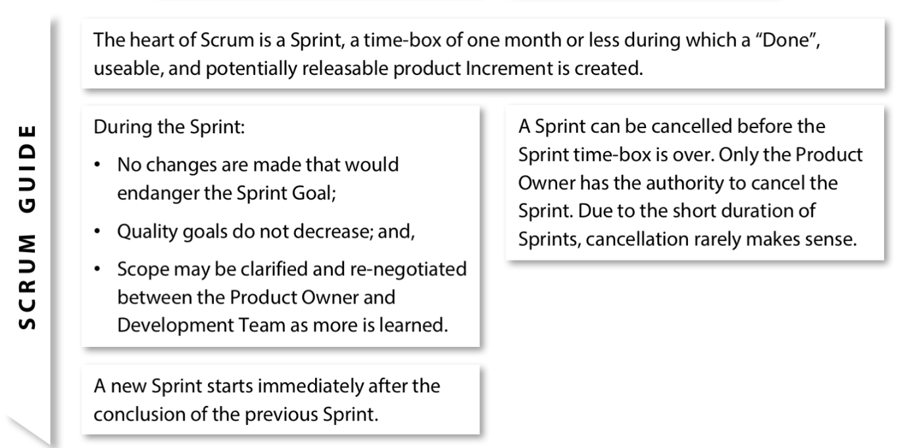
Sprint (A time-box during which a Done Increment is created)

Slide 8
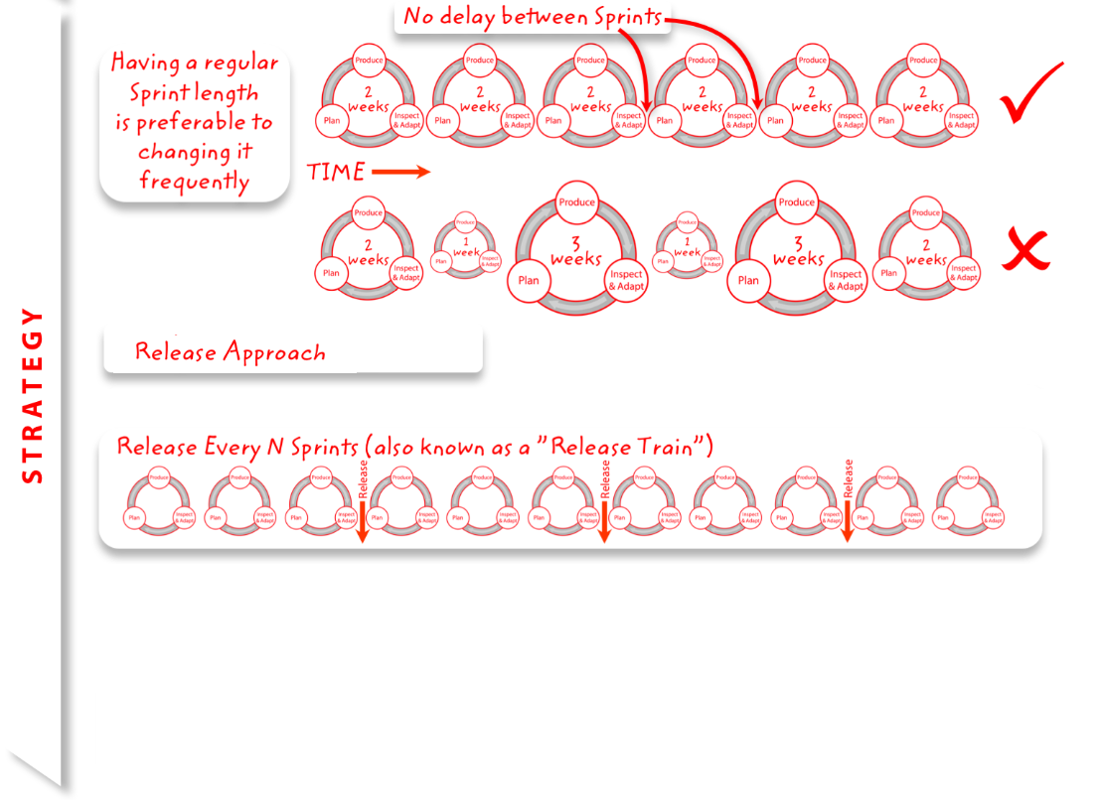
Sprint (A time-box during which a Done Increment is created)

Slide 9







Scrum Roles
Product Owner
Defines product features, release priorities, backlog prioritization
Scrum Master
Responsible for enacting Scrum values and practices
Remove impediments keeps everyone productive
Development Team
6 to 9 members, self-organized
Cross-functional: QA, Programmers, UI Designers, DevOps etc.

Slide 10


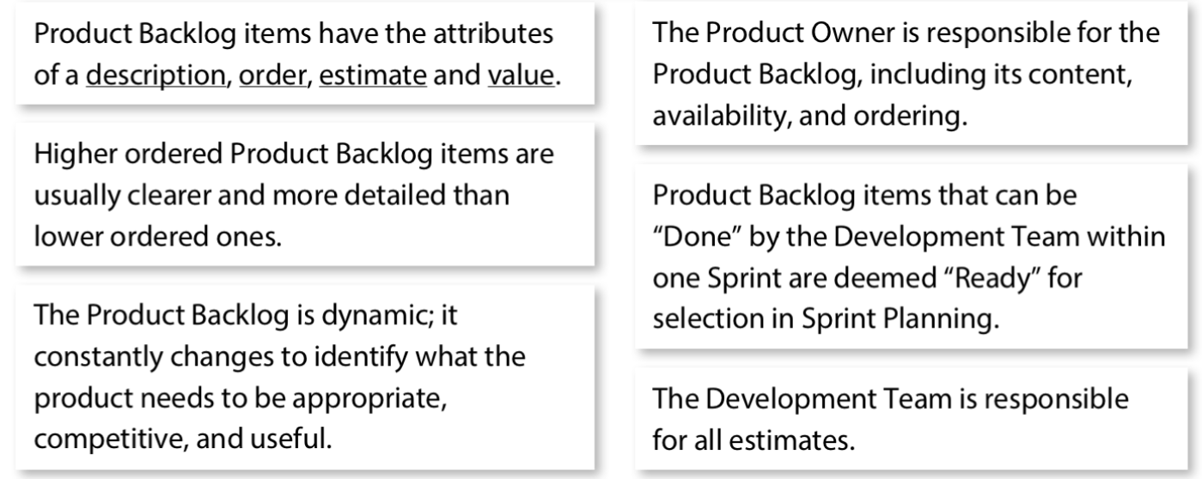
Product Owner (Responsible to maximize the value of product)
Product Owner is project's key stakeholder. Product owner’s major responsibility is to have a vision of what he or she wishes to build, and convey that vision to the scrum team. The Product owner is one person, not a committee.

Slide 11
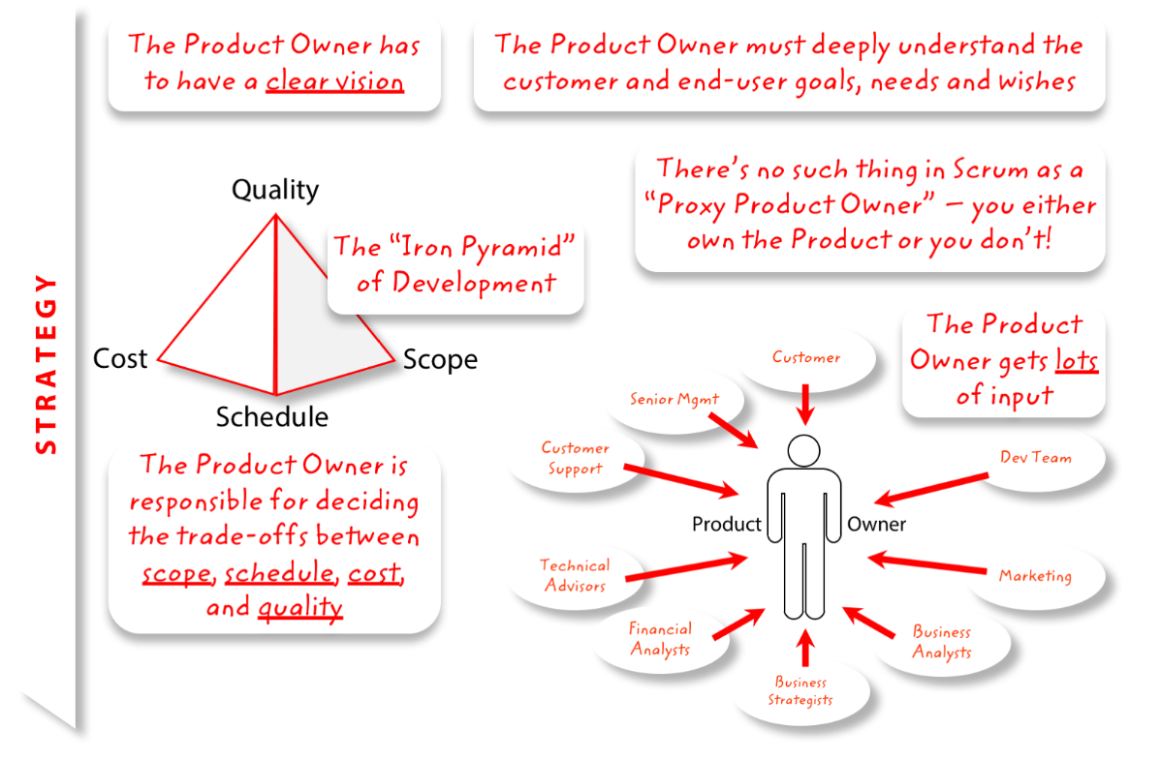
Product Owner (Responsible to maximize the value of product)

Slide 12
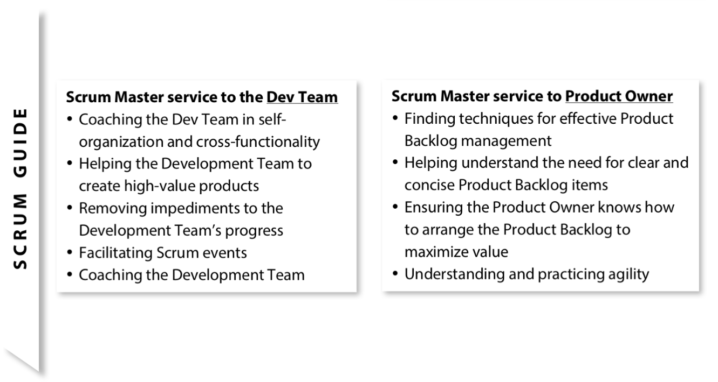
Scrum Master (A Servant leader for the Scrum Team)

Slide 13
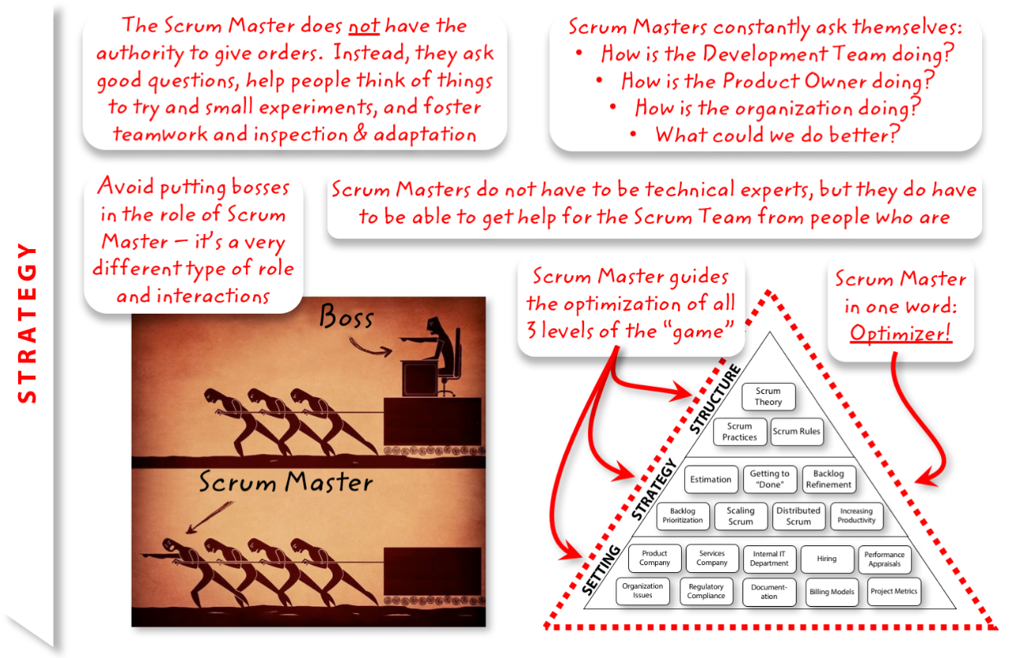
Scrum Master (A Servant leader for the Scrum Team)

Slide 14
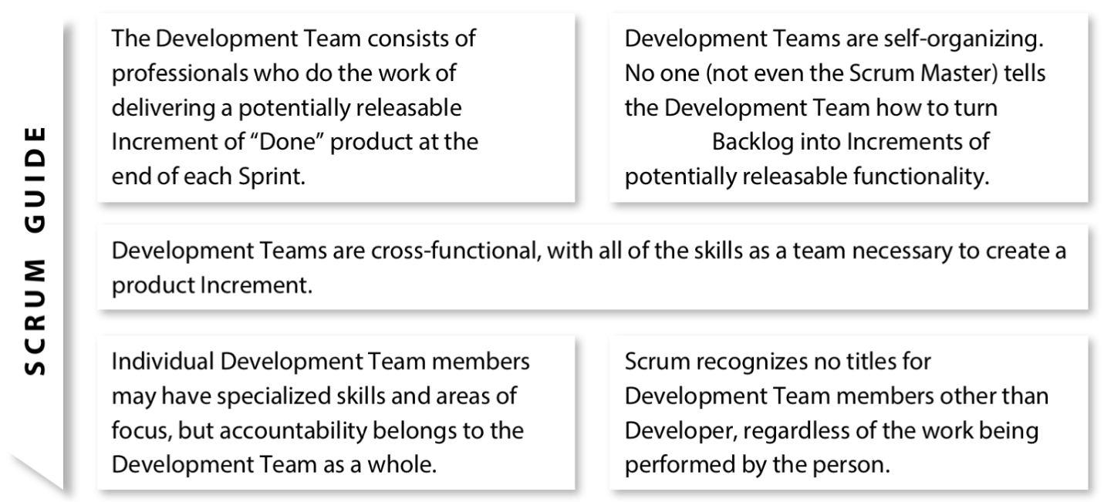
Development Team (Professionals who deliver a potentially releasable increment of “DONE” product at the end of each sprint)
Sprint

Slide 15
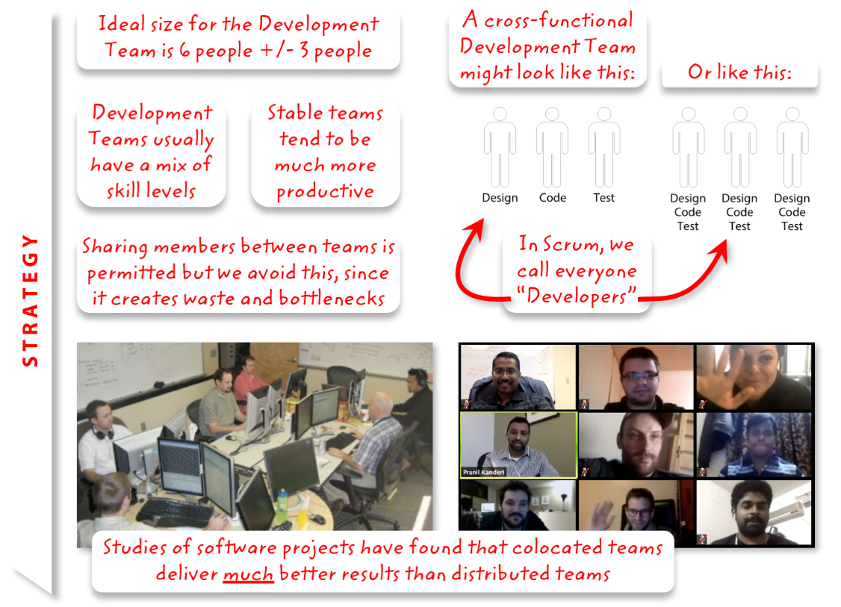
Development Team (Professionals who deliver a potentially releasable increment of “DONE” product at the end of each sprint)

Slide 16
Sprint Ceremonies
Sprint Planning
Daily Scrum
Sprint Review (including Show & Tell)
Sprint Retrospective
Product Backlog Refinement
Sprint planning
Sprint review
Sprint retrospective
Daily scrum
Backlog refinement

Slide 17

Sprint Planning (Set the goal of sprint and plan the work)
Team capacity
Sprint prioritization
Product backlog
Analyze/evaluate product backlog
Business conditions
Sprint planning
Decide how to achieve sprint goal (design)
Create sprint backlog (tasks) from product backlog items (user stories / features)
Estimate sprint backlog in hours
Current product
Sprint
backlog
Technology

Slide 18

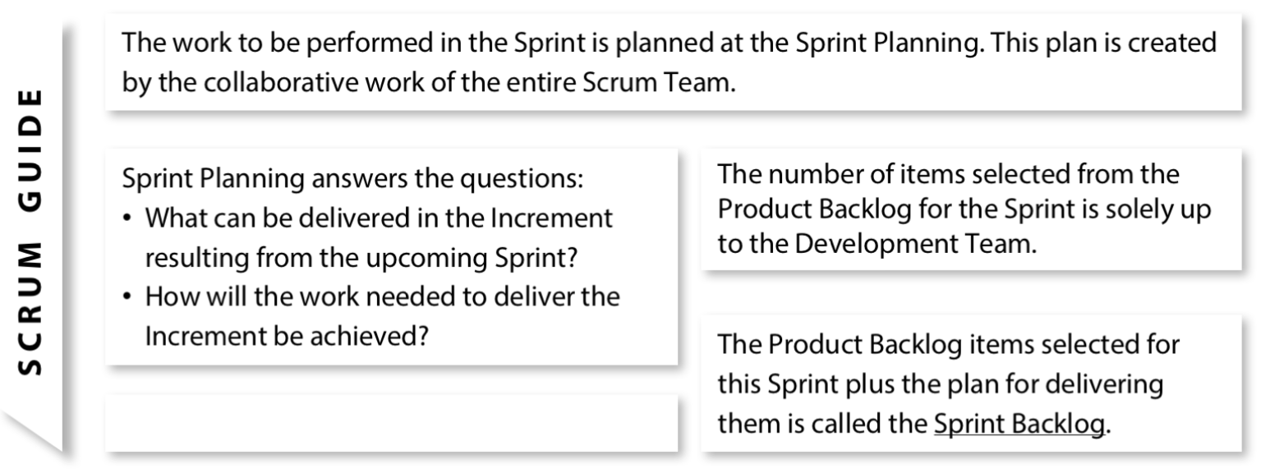
Sprint Planning (Set the goal of sprint and plan the work)
Sprint planning agenda: Product Owner
Process Facilitator: Scrum Master
Estimation: Development team
Timebox: 1 Day

Slide 19
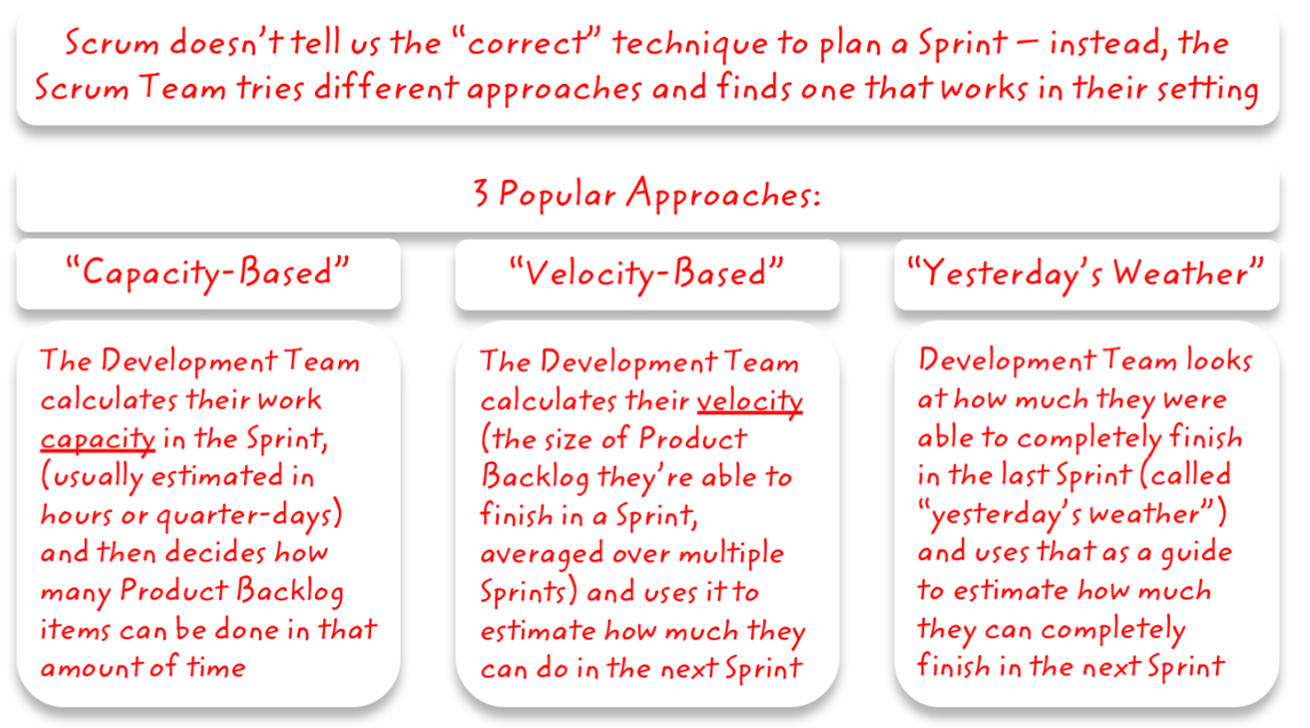
Sprint Planning (Set the gaol of sprint and plan the work)
We are using Capacity Based Approach due to unknown and spikes in our initial sprints eventually we will move to Velocity based approach

Slide 20
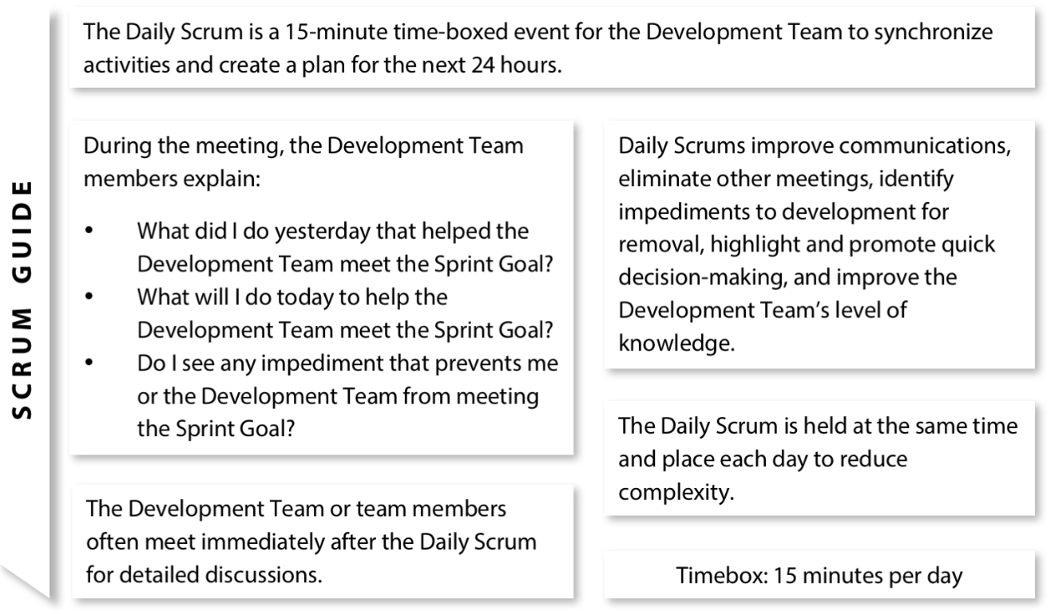
Daily Scrum (Daily Inspect and Adapt the Product)
Process Facilitator: Scrum Master
Participant: Development team

Slide 21
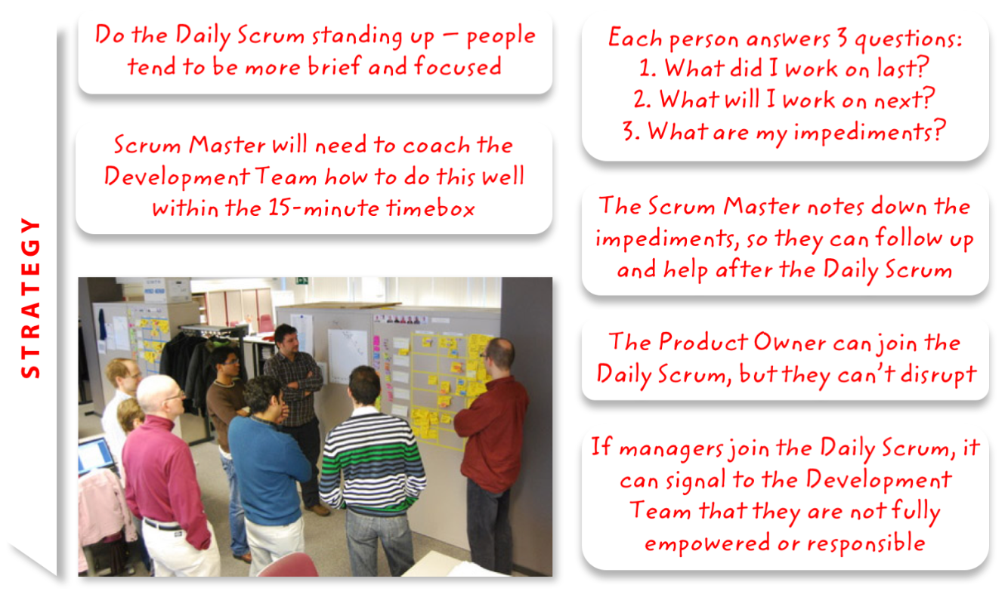
Daily Scrum (Daily Inspect and Adapt the Product)

Slide 22
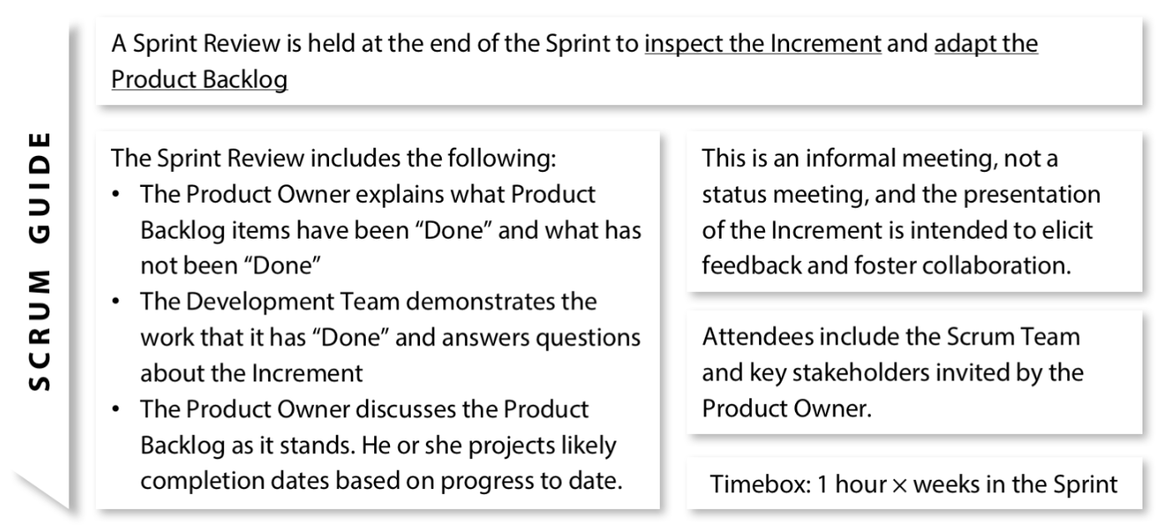
Sprint Review (incl. Show & Tell) (Inspect and Adapt the Product)
Sprint Review Execution: Product Owner & Development team
Process Facilitator: Scrum Master
Participants: All Stakeholders (invited by PO)

Slide 23
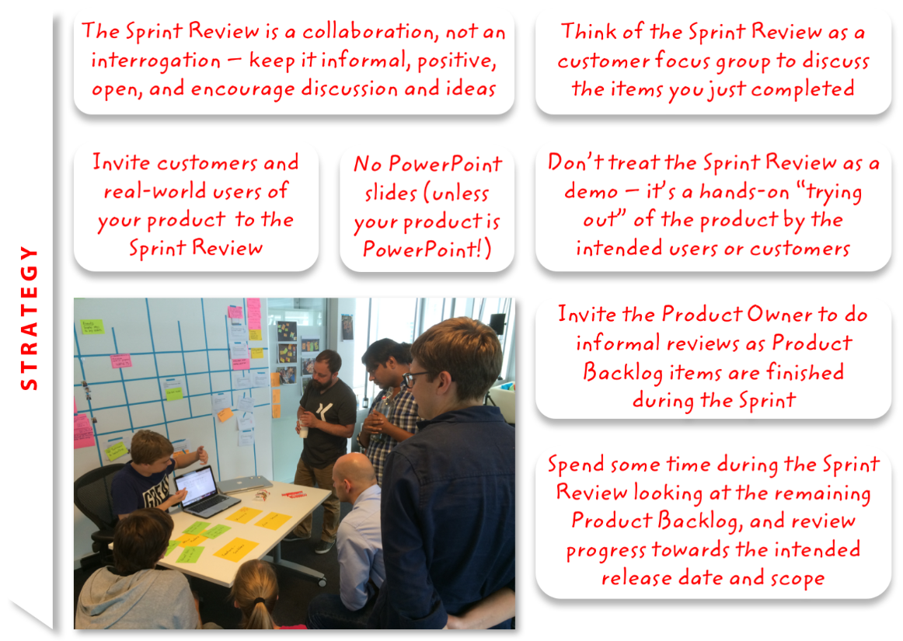
Sprint Review (Inspect and Adapt the Product)

Slide 24
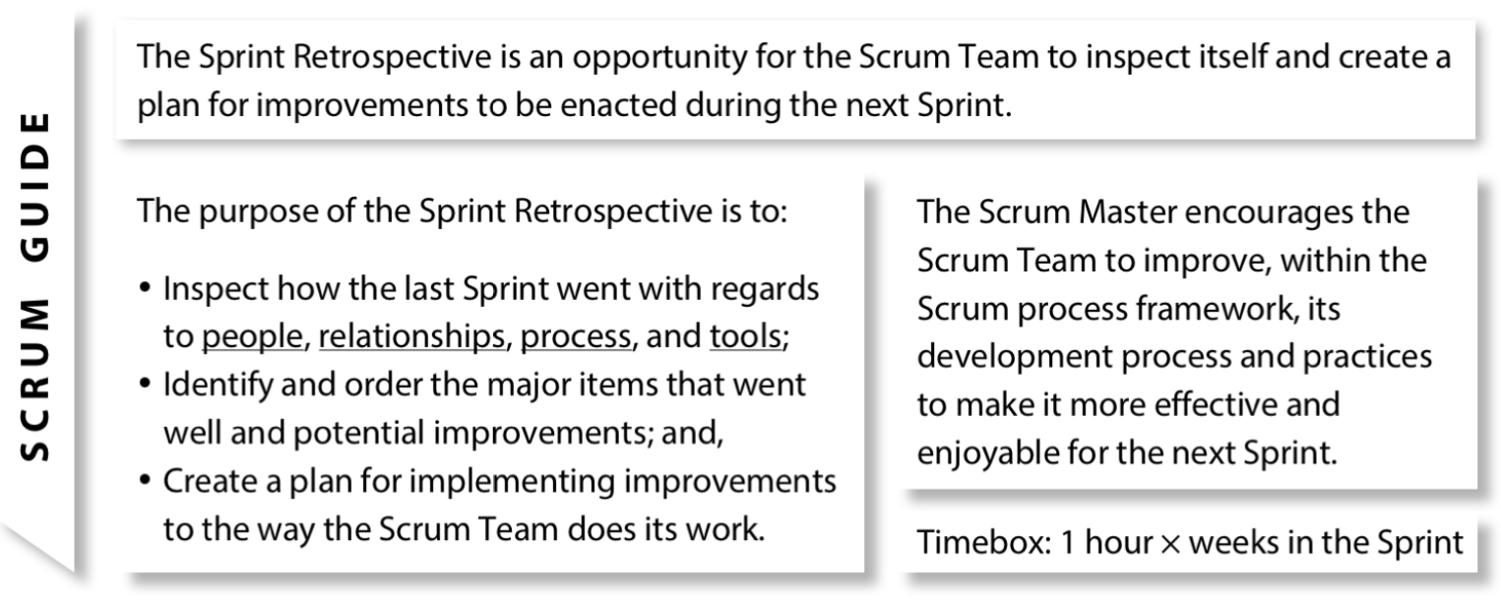
Sprint Retrospective (Inspect and Adapt the Process)
Process Facilitator: Scrum Master
Participants: Scrum Team

Slide 25
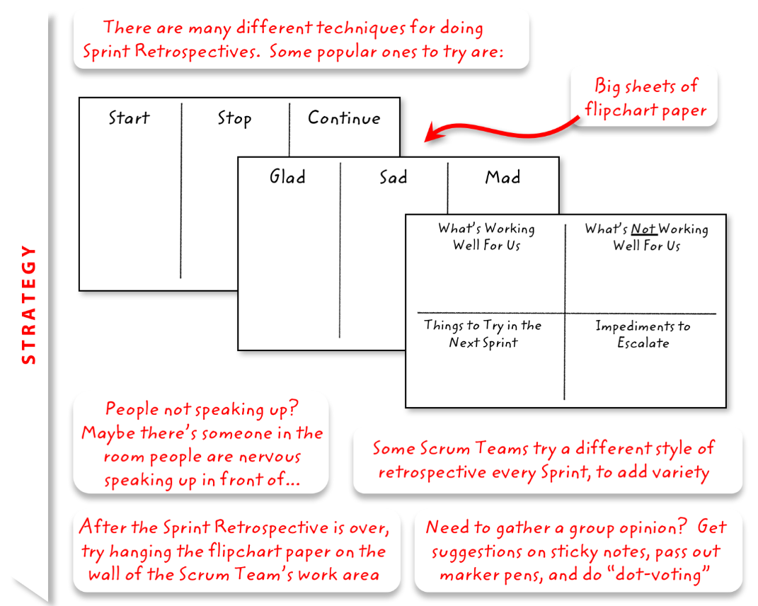
Sprint Retrospective (Inspect and Adapt the Process)

Slide 26
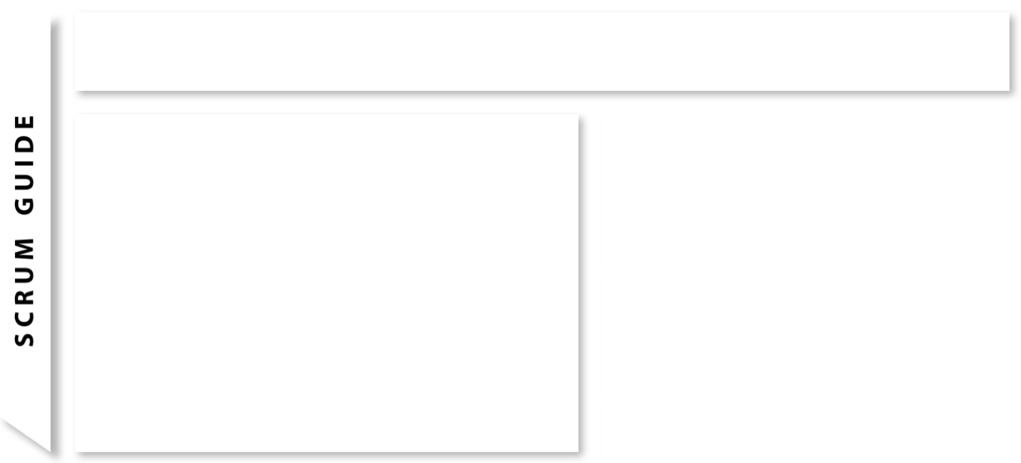
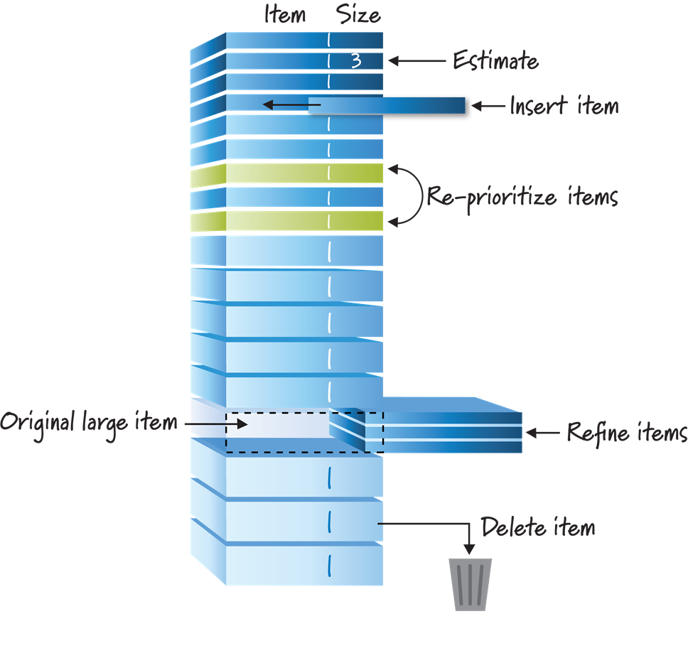
Product Backlog refinement (Method for keeping backlog updated, clean and ordered)
Backlog refinement: Product Owner & Development team
Process Facilitator: Scrum Master
Product Backlog refinement is an activity with Product Owner, Development Team and stakeholders (when relevant), to get Product Backlog items in a “ready state”
Product Backlog is an ordered list of items that represent changes / additions that need to be made to the product
Highest value items are at the top
Large items are broken down into smaller pieces
Priorities are changed based on feedback from each release, changing markets etc.
Rinse - repeat

Slide 27
Scrum Artifacts
Product Backlog
Sprint Backlog
Burndown Chart
Kanban Board

Slide 28
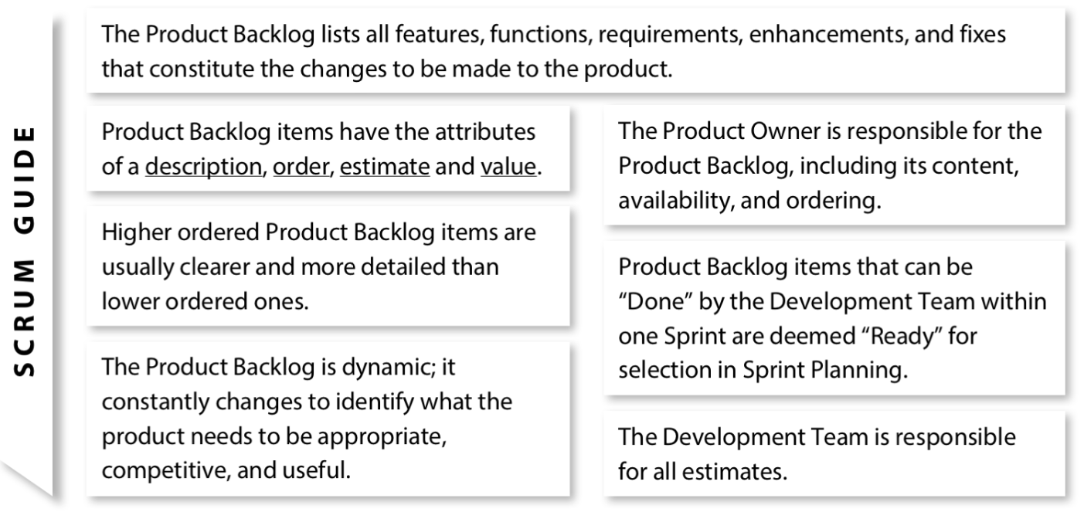
Product Backlog (An ordered list of everything that is required in product)

Slide 29
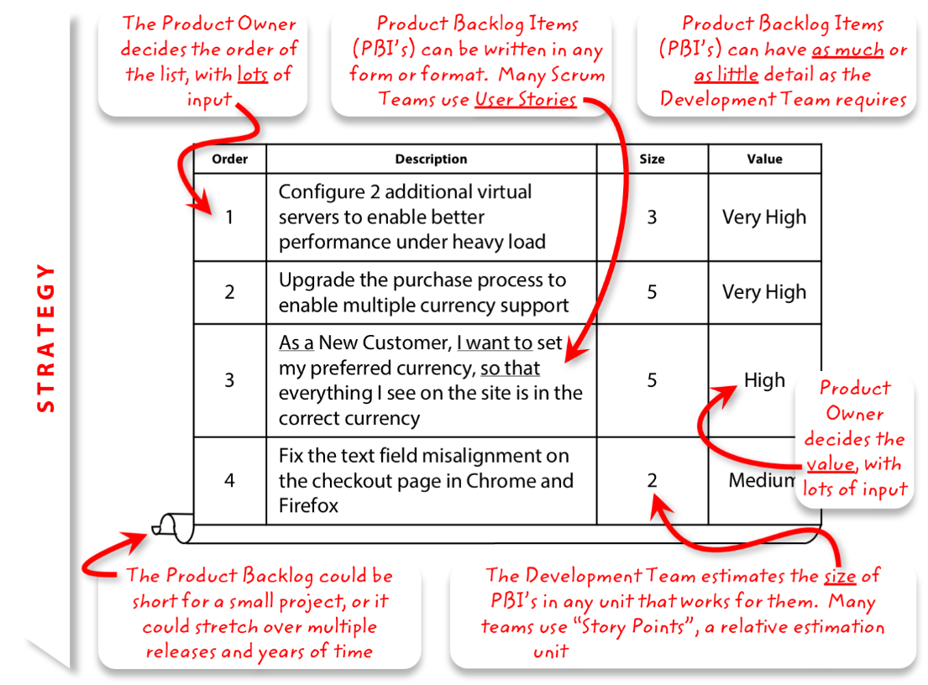
Product Backlog (An order list of everything that might be needed in the product)

Slide 30
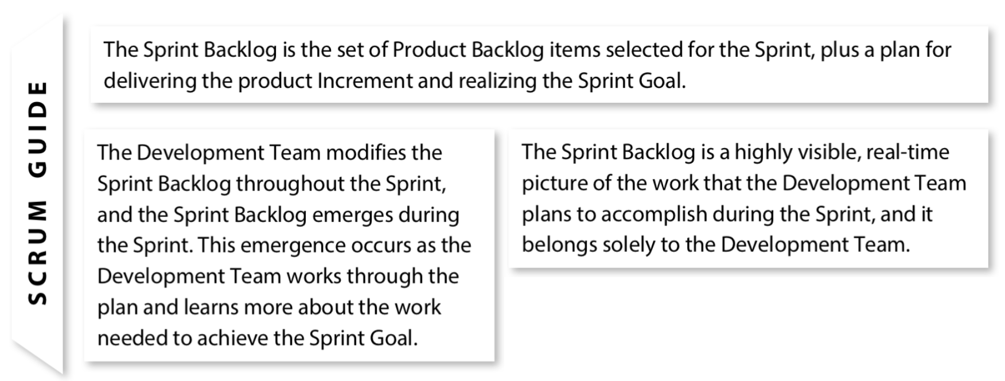
Sprint Backlog (The set of product backlog items selected for the sprint, plus a plan)

Slide 31
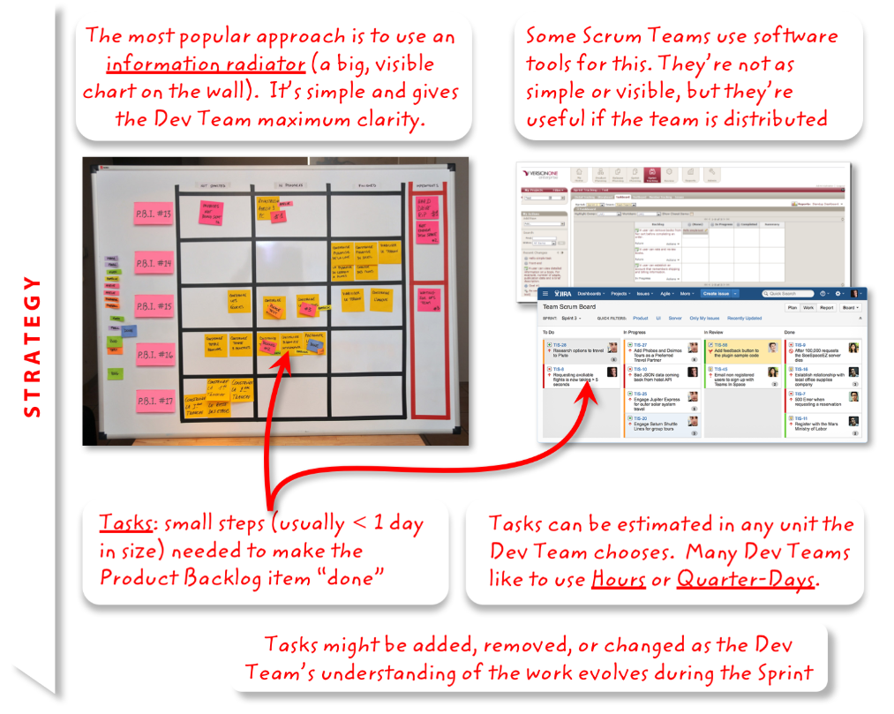
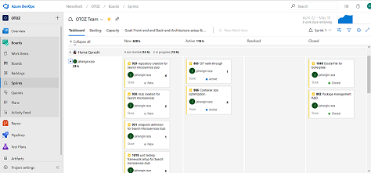
Sprint Backlog (The set of product backlog items selected for the sprint, plus a plan)

Slide 32
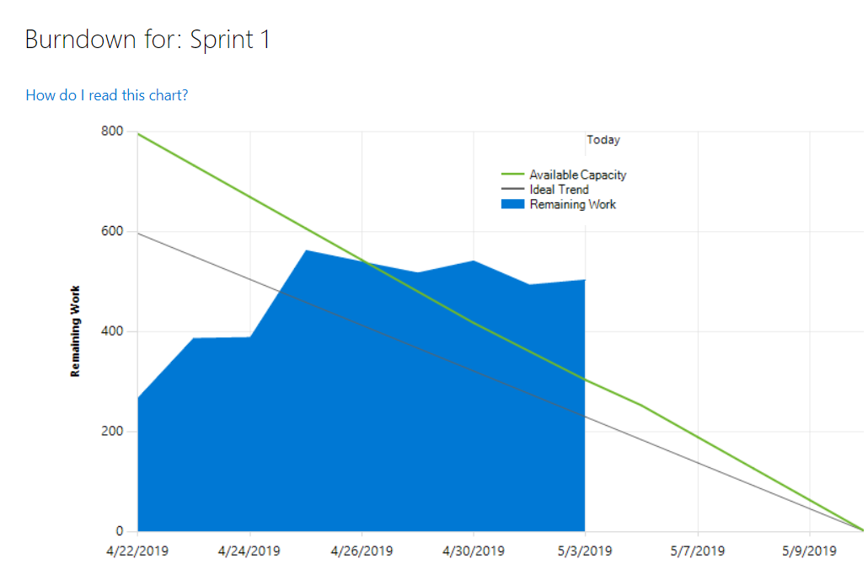
Sprint Burndown (Daily net change in the amount of work remaining)
A display of what work has been completed and what is left to complete
one for each developer or work item
updated every day
(make best guess about hours/points completed each day)
Variation: Release burndown chart
shows overall progress
updated at the end of each sprint
Sprint burndown needs daily logging of
completed hrs. and remaining hrs.

Slide 33
Definitions

Slide 34
Definition of Ready (DoR) for User Story
Definition of Ready (DoR)
Well-defined User story
User story acceptance criteria defined
User story sized by the delivery team (Story Points)
Scrum team accepts user experience artifacts
Performance criteria identified (need to check)
The Person who will accept the user story is identified (Moazam)
A Team is able to ‘demo’ the user story.

Slide 35
Definition of Done (DoD) for User Story
Definition of Done (DoD) for User Story
DOR is completed
Test cases are written added to repository
Coding Task(s) Completed
Unit Tested
Code Reviewed
Code is updated in repository according to branching strategy
Test Cases are executed (manual/automated if required)
User story passes acceptance criteria

Slide 36
Thank You

